Slide 1

Policy Data Overview

Slide 2
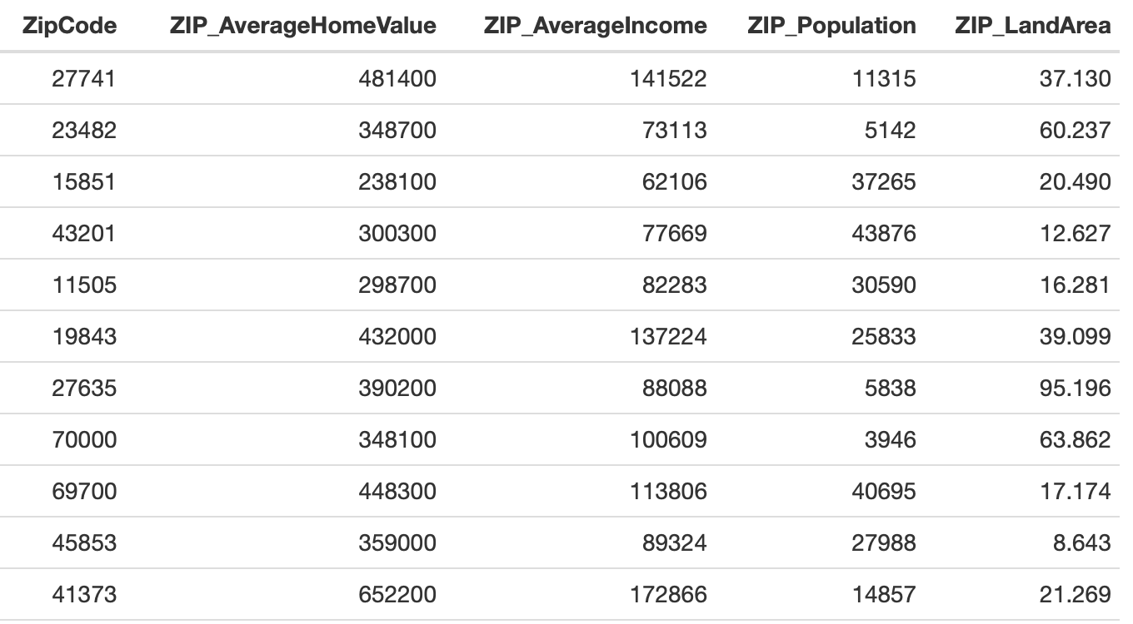
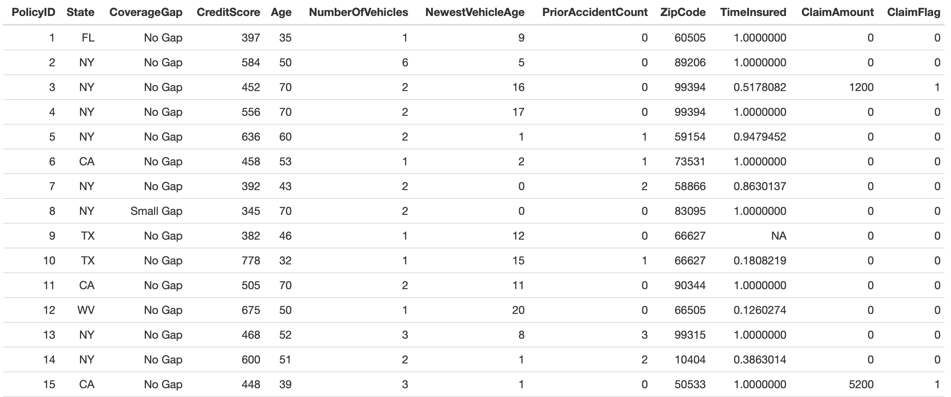
The Data
Two datasets available - Policy data and Geographical data, which share a common identifier ZipCode, enabling us to combine the two datasets.
One row per observation (PolicyID) - perfect for modelling.
The combined dataset consists of 16 variables (columns), and 74,446 observations (rows), with a selection of continuous and categorical variables including CreditScore and ClaimFlag.

Slide 3
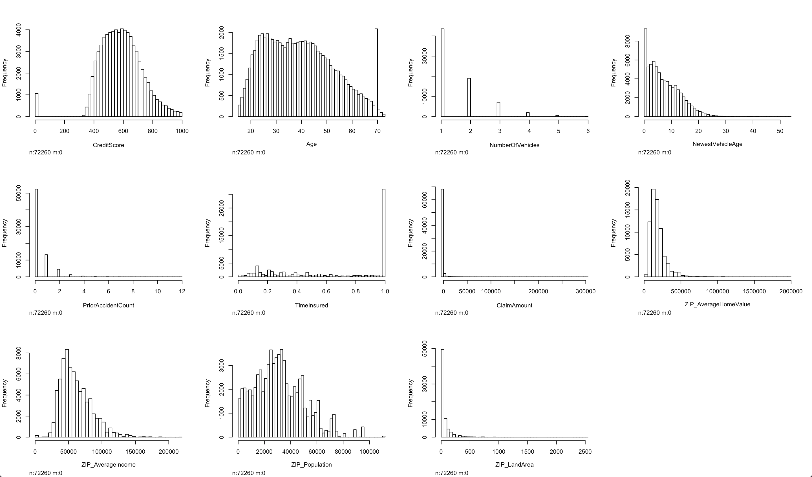
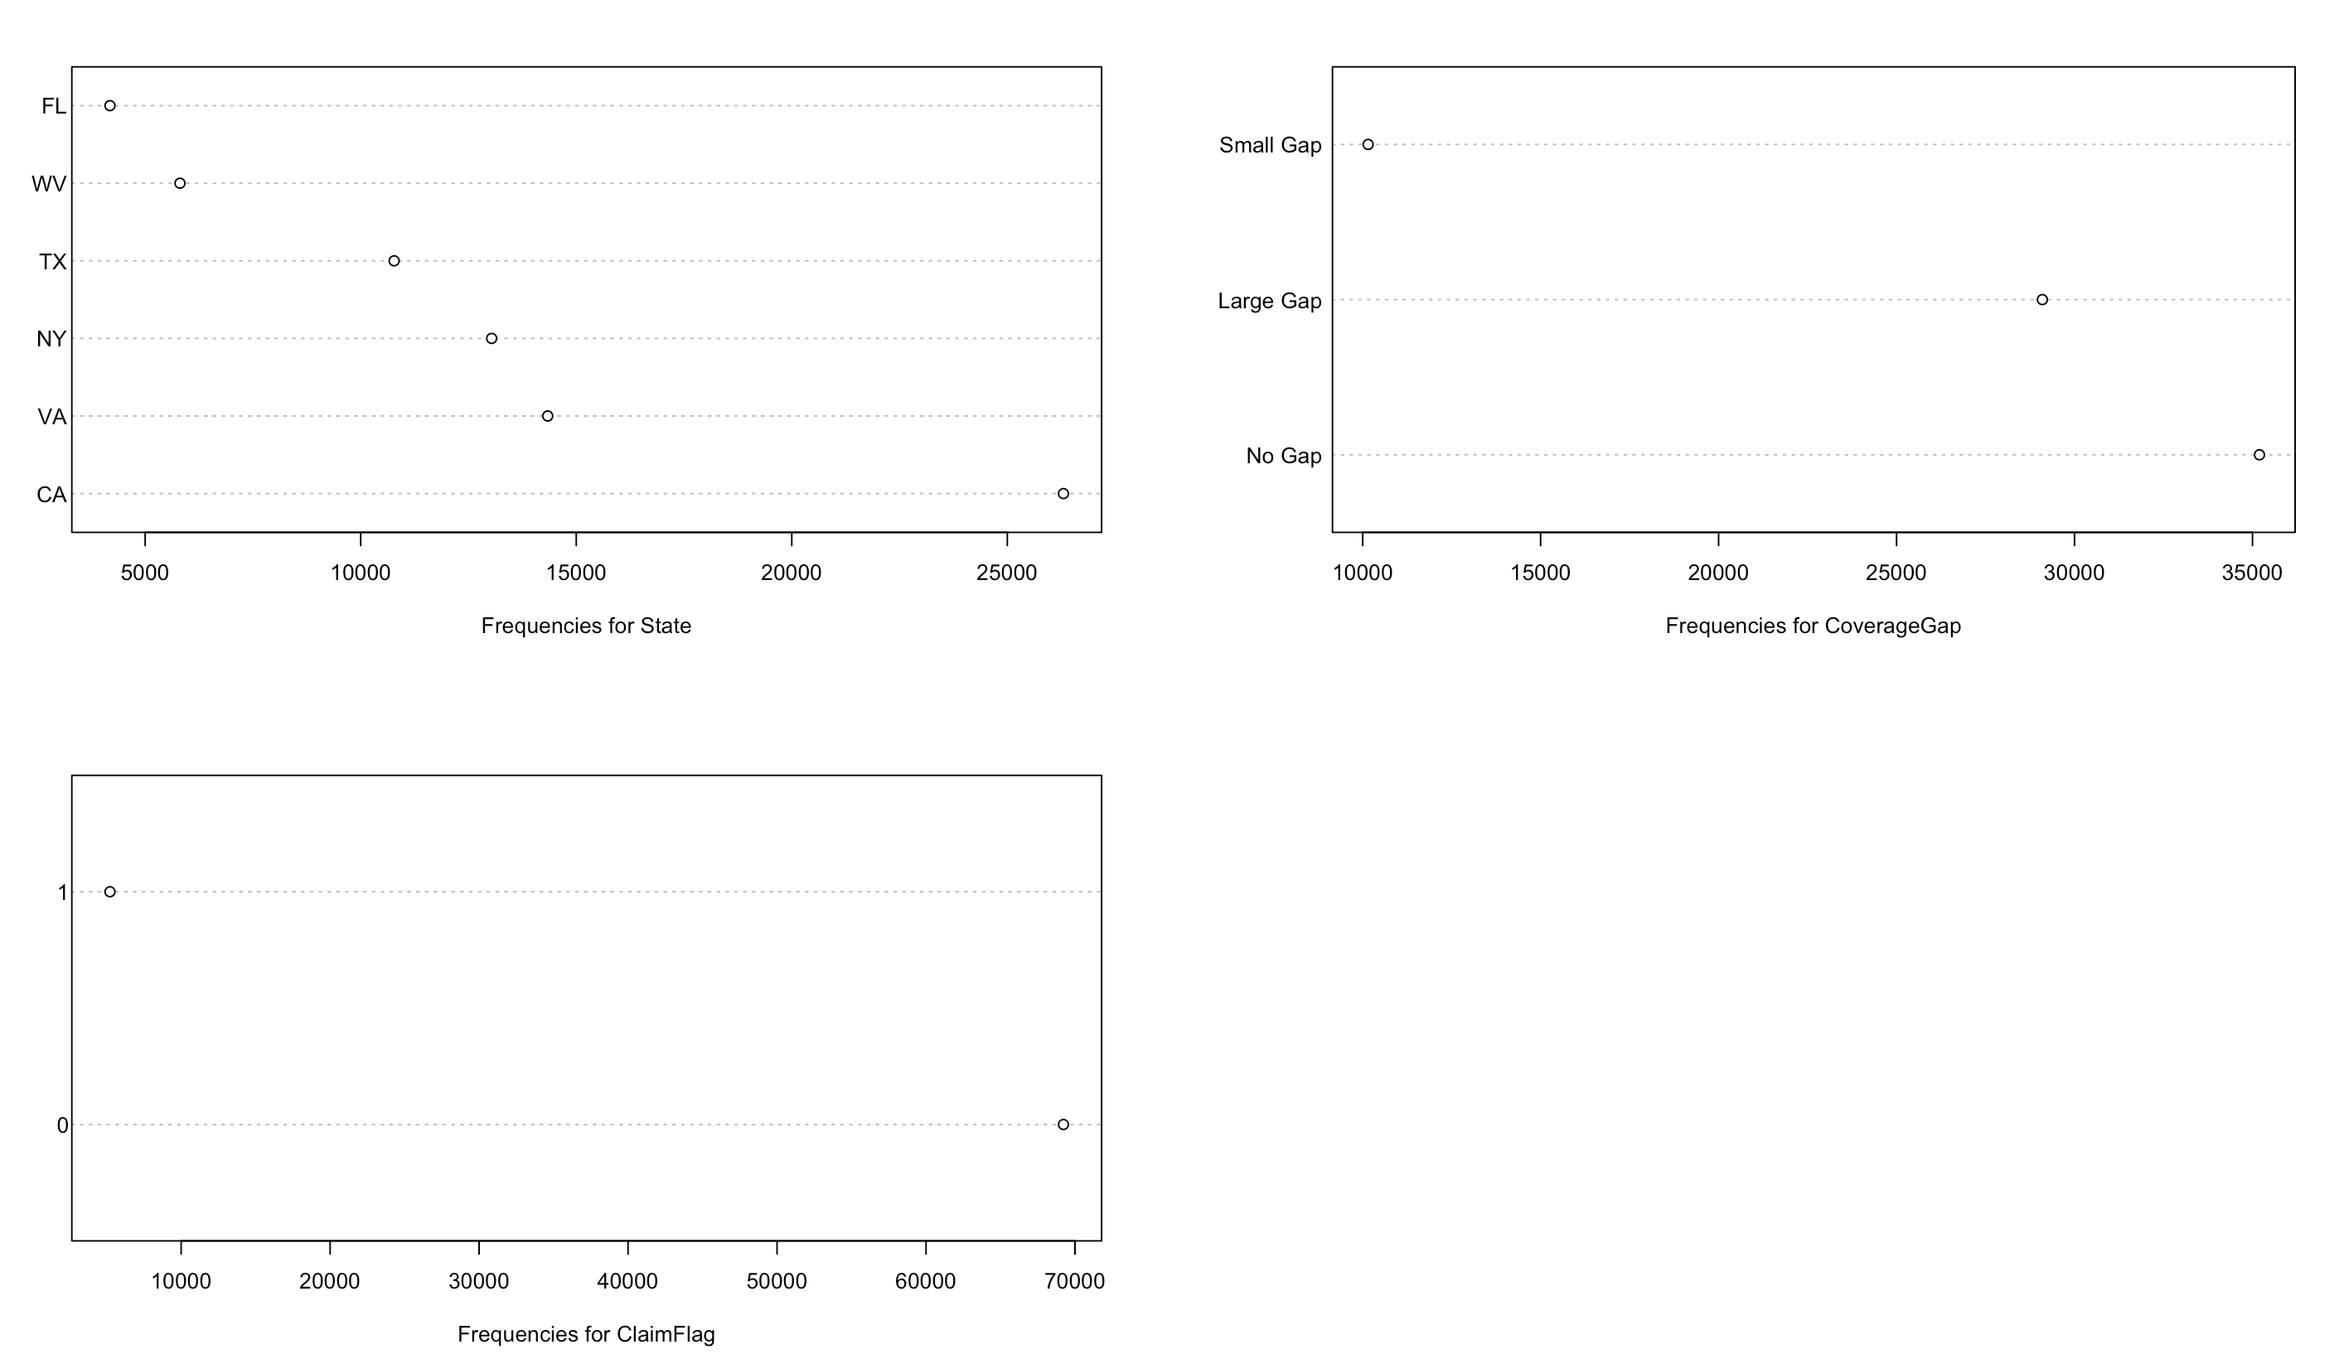
Data Consistency
Continuous Variables
Categorical Variables
Continuous variables have a good spread of data however vastly different ranges when comparing.
For example, Age ranges from 15-73, whereas NumberOfVehicles ranges from 1-6.
Continuous variables will therefore need normalised to get all variables on a common scale or grouped/feature engineered, before modelling.
Spikes within distribution of CreditScore and Age (highlighted above) which do not flow with usual distribution. Credit Score has a spike at 0, and Age at 70.
Further investigation needed into these variables, to confirm if this data is correct.
Categorical variables show frequency count for each group.
ClaimFlag shows much higher frequencies for ‘0’, than ’1’.
For modelling, if this variable were to be our response, we would require that our train/test datasets contain equal proportions of each factor/group (0/1).

Slide 4
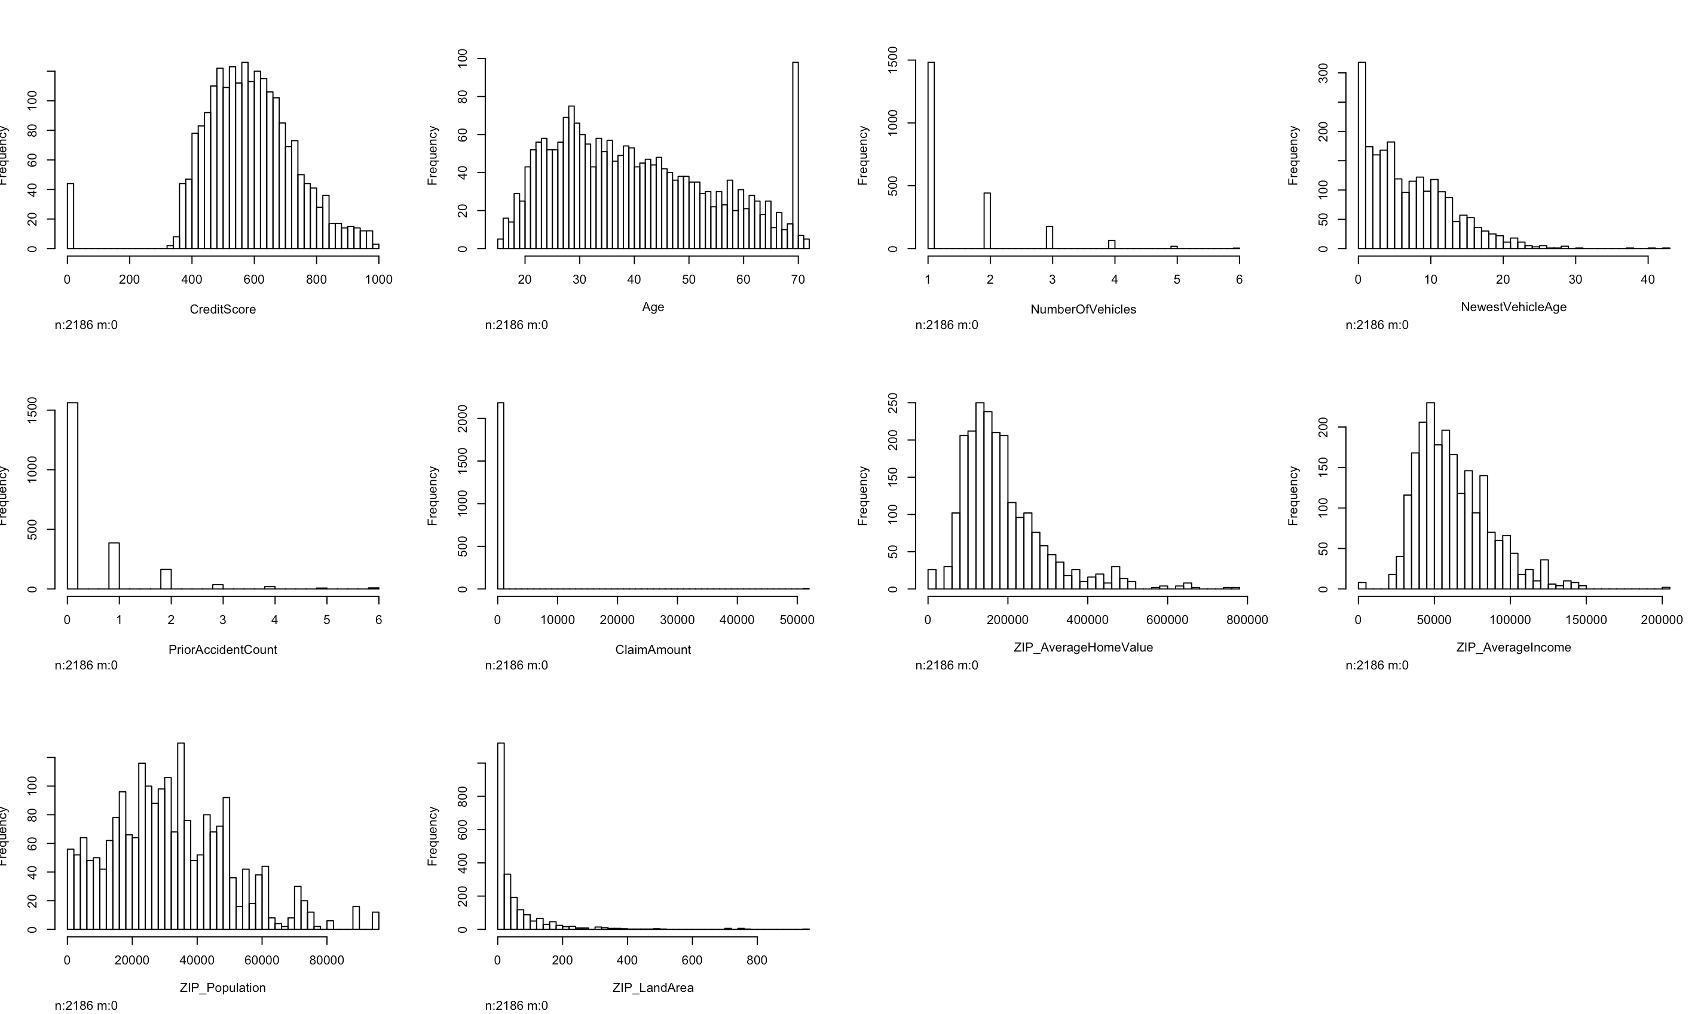
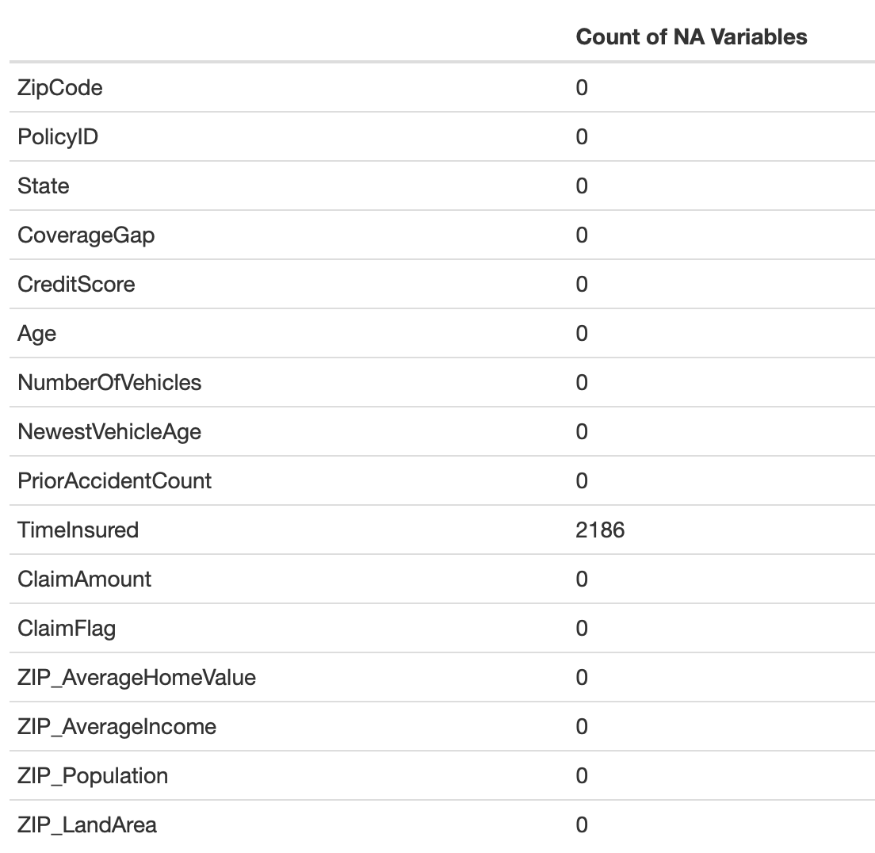
Data Completion
Data completion is key for modelling.
The only column which contains missing data is TimeInsured, with 2186 missing data points (2.9%).
Before modelling, we need to understand why data is missing. Dependent on the result, we can either remove the missing data, or impute predicted values.
Segmenting the observations with missing values allows us to look for trends within distributions of other variables, relative to the missing variable (highlighted above).
ClaimAmount for missing observations is consistently 0, indicting a trend. Are these missing values for TimeInsured new customers, where policies have not started yet? Confirmation needed.

Slide 5
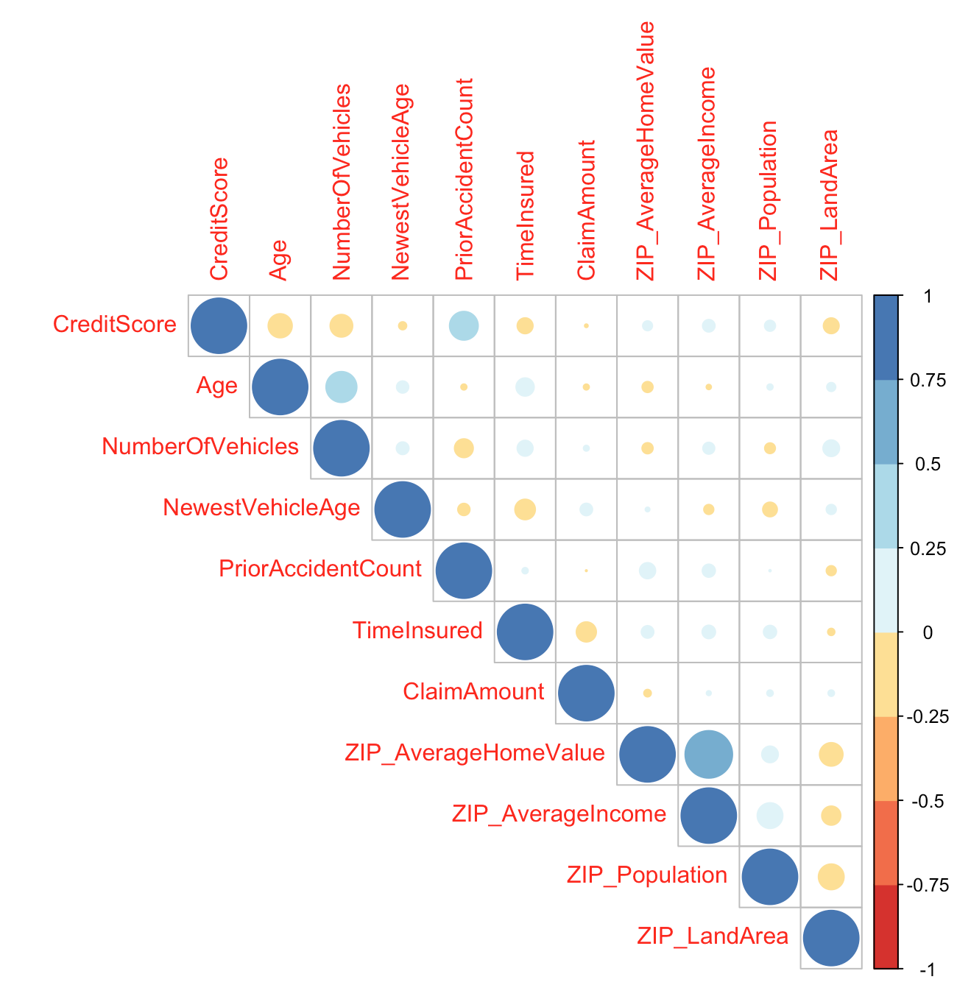
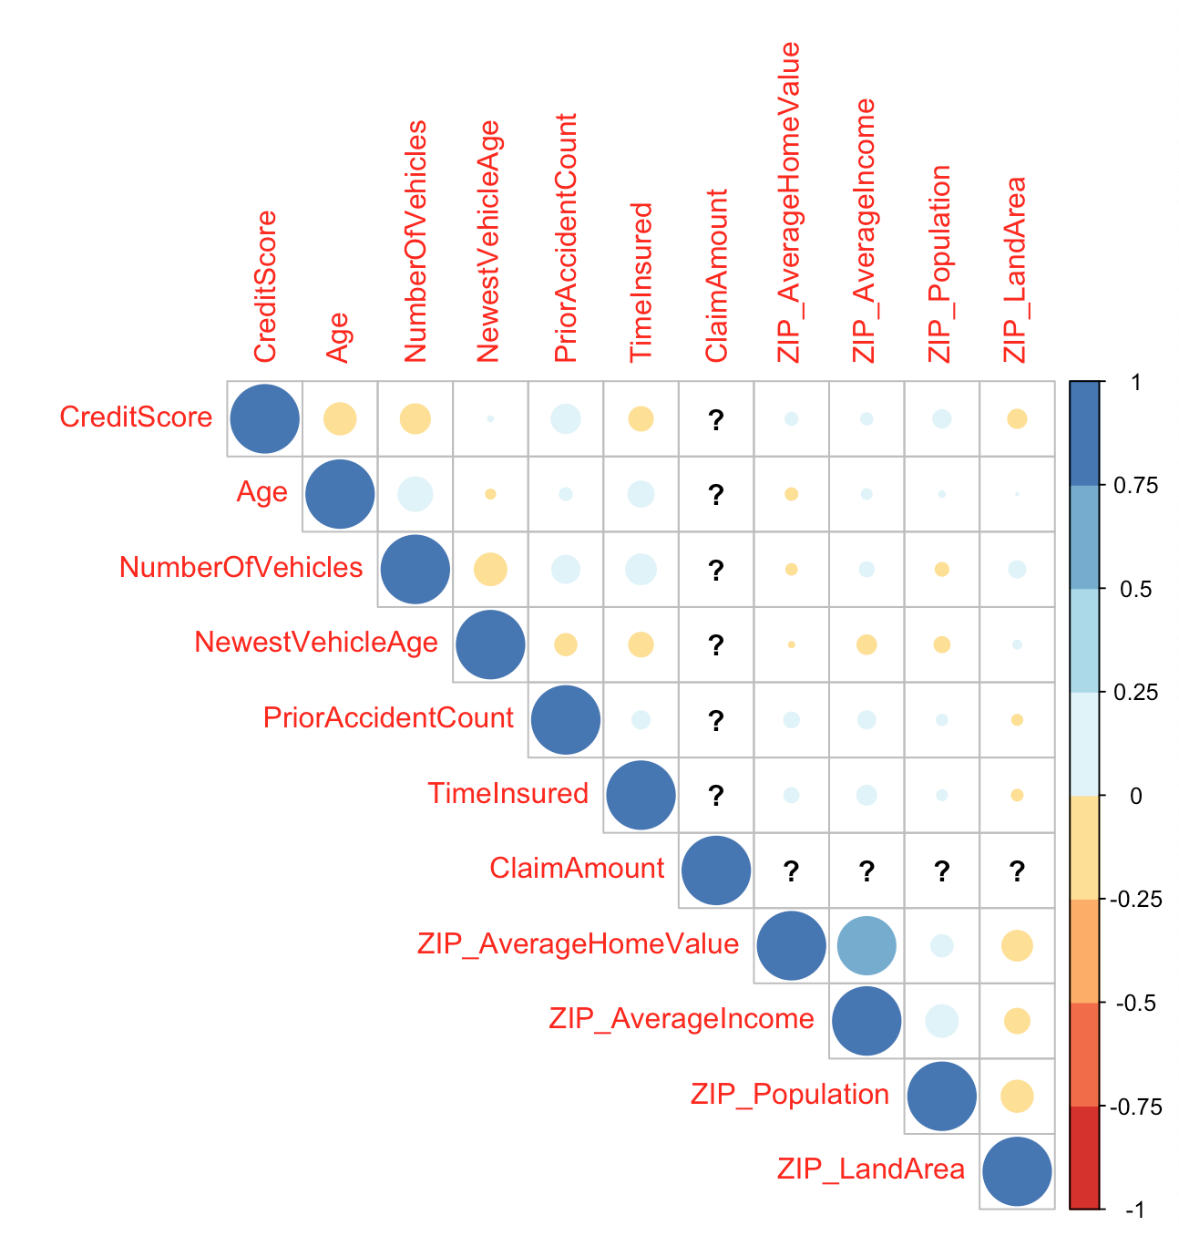
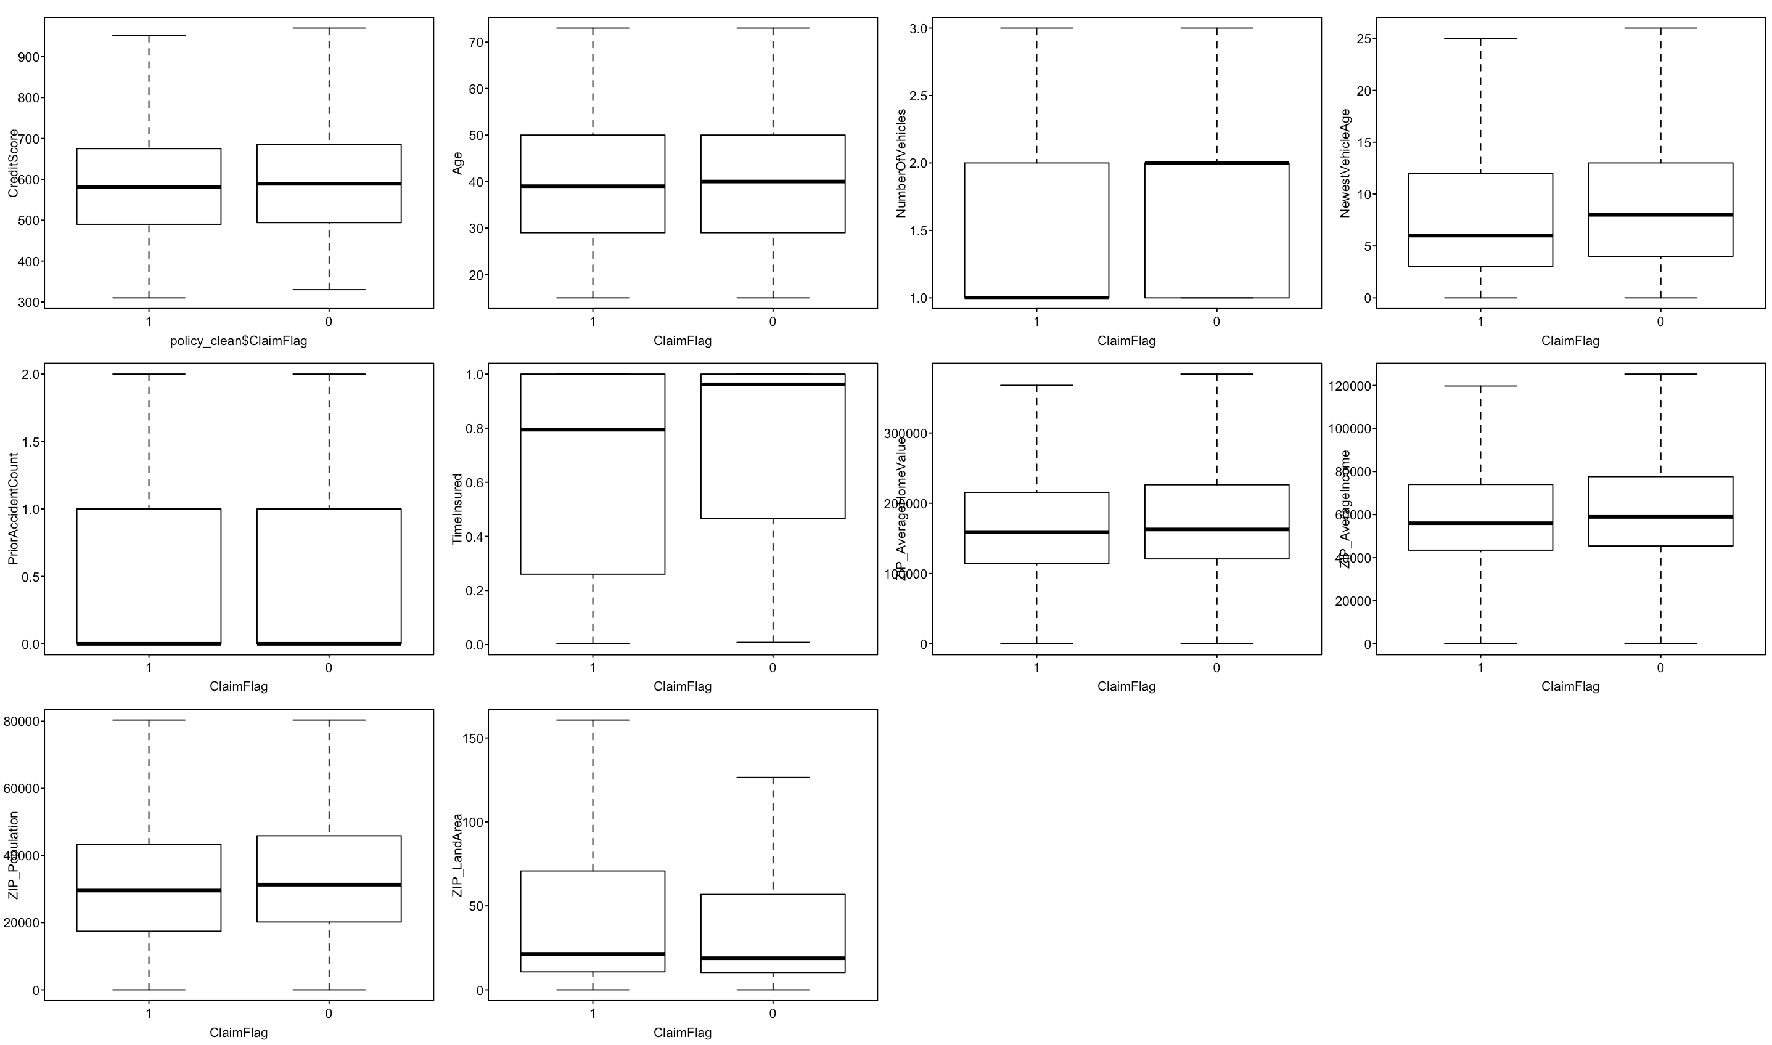
Data Correlations & Potential Model Build
Continuous Variables
Categorical Variables
ClaimFlag=1
ClaimFlag=0
Correlation plots between numerical values allows us to see the relationship between variables, and how they will impact each other within a predictive model.
When analysing ClaimFlag groups (0/1), we can already see trends between variables.
For example, the NumberOfVehicles column outputs vastly different results dependent on ClaimFlag response.
However, we’re not seeing many high correlations (>0.5, -0.5), hence a more advanced model may be required to find relationships.
Box plots for categorical variables shows how data varies for each categorical group. Good variance, and some differences between ClaimFlag groups.
Variances, correlations and trends will be key in building a model. Once data is normalised, cleaned (handled NA values and investigations into spikes in distribution), the data will be a good source for modelling.

